Slide 1
The Estates Director’s influence on the financial profile of an ever-developing estate
Jon Milward, Ben Powell & Laurie Pay | 25 January 2018
Notes:
#[TitlePage]

Slide 2
Who are we?
Jon Milward – Financial Advisory Real Estate
Partner
Head of Real Estate Development
T: +44 20 7303 3843
jmilward@deloitte.co.uk
Ben Powell
Partner
National Public Sector
Tax Lead Partner
M: +44 7881 804 171
bpowell@deloitte.co.uk
Laurie Pay – Indirect Tax
Director
National Education
Tax Lead
T: +44 121 695 5296
lpay@deloitte.co.uk
Deloitte Confidential: Public Sector – For Approved External Use

Slide 3
Session Synopsis
“The session will look at the future and how Universities may need to develop their estates in order to maximise revenue, minimise cost and reflect the diverse activities of the HE sector. The session will focus on some of the finance and cost implications to be aware of, and the positive influence that estates teams will have on this and how innovations may assist. Deloitte will explore areas such as research and commercial facilities, sporting facilities and student accommodation and using case-studies will consider the challenges and opportunities involved in such developments.”
Deloitte Confidential: Public Sector – For Approved External Use

Slide 4
Agenda
1
Estates in the HE Sector:
An Overview
2
The Future of the Higher Education Estate
3
Meeting the Demand for World-class Facilities
4
Key Take Aways from the Session
5
Questions
Deloitte Confidential: Public Sector – For Approved External Use

Slide 5
Estates in the HE Sector:
An Overview

Slide 6
Estates in the Higher Education Sector: An overview
The UK University estate is managing an additional 500,000m² of space in addition to a comprehensive refurbishment of older buildings.
Total property cost (revenue spending) remain at £2.04bn with the largest costs:
Repairs & maintenance: £701m
Energy costs: £376m
Cleaning costs: £244m
Security costs: £154m
Management costs: £304m
HE owned and managed beds on residential estates total 261,000 beds with a further 110,000 which are leased by the sector directly from the private sector.
Increase in estate utilisation of 4% between 2014/15 - 2015/16 and 14% between 2013/14 - 2014/15.
80% of the capital expenditure was by 54 out of 154 institutions. The median capital expenditure is £10m.
Capital expenditure in UK university estate reached £3bn a year in 2015/16
Source: AUDE Estates Management Report 2017
Deloitte Confidential: Public Sector – For Approved External Use

Slide 7
The Future of a Higher Education Estate

Slide 8
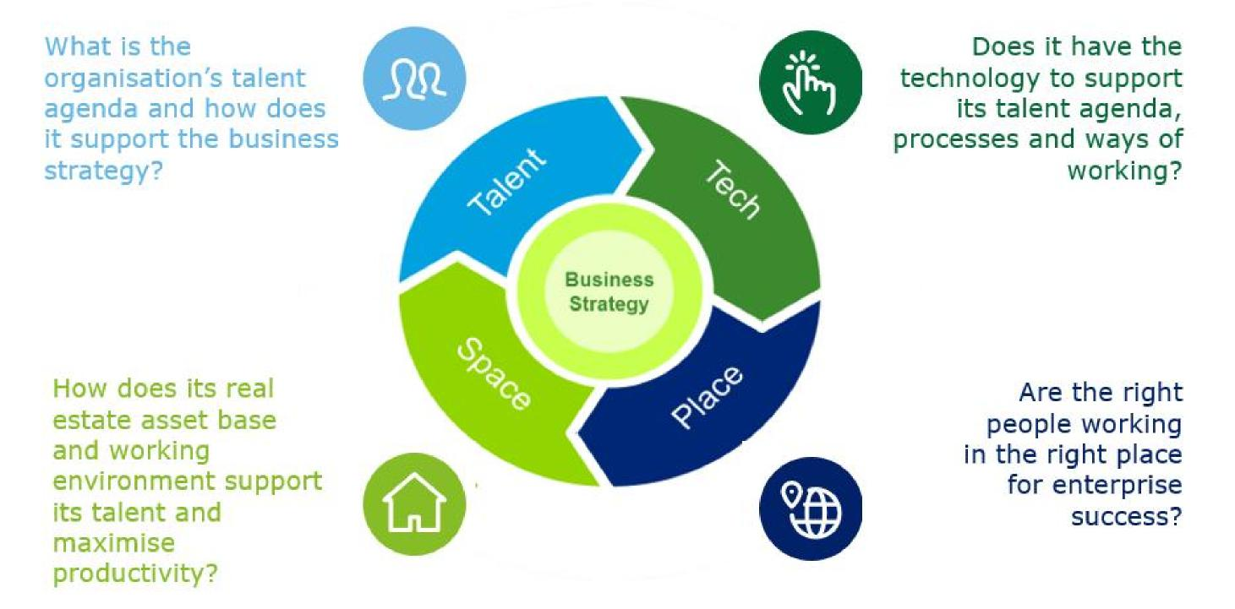
Our Work+Place framework connects the debate
We transform an organisation’s real estate and workplace strategies by colliding our clients’ increasingly connected Talent, Technology, Place and Space agendas
Deloitte Confidential: Public Sector – For Approved External Use

Slide 9
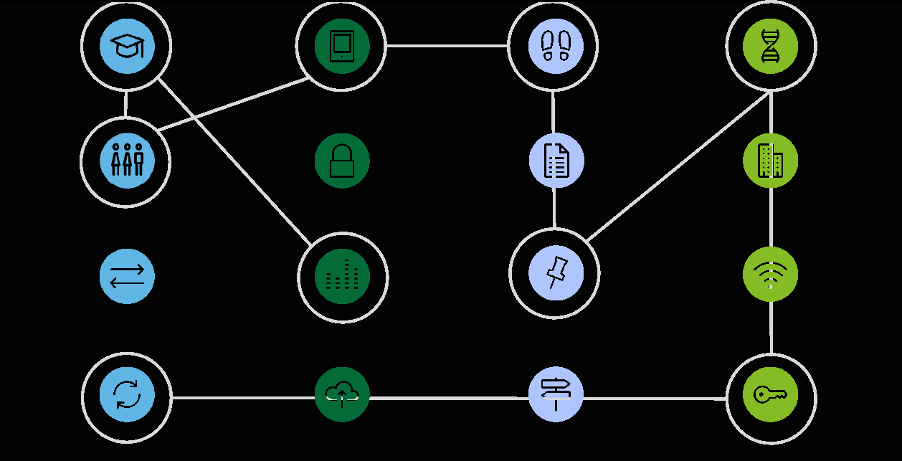
Siloed decision making is a barrier best use
Strategies crafted in historically siloed functions can have significant impacts across the organisation. Place and Space decisions uninformed of wider Talent and Technology strategies will fail to exploit the potential value real estate assets can deliver to their occupiers
TALENT TECHNOLOGY PLACE SPACE
TALENT STRATEGY & WORKFORCE PLANNING
DIGITAL COLLABORATION & MOBILITY
FOOTPRINT OPTIMISATION
WORKPLACE VISION
AGILITY & HYBRID WORKFORCE
REGULATION, TAX & INCENTIVES
AGILITY & HYBRID WORKFORCE
SECURITY
& CYBER RISK
REAL ESTATE STRATEGY
ORGANISATIONAL TRANSFORMATION
ORGANISATIONAL TRANSFORMATION
ROBOTICS & AUTOMATION
LOCATION STRATEGY
CONNECTED BUILDINGS & IoT
CHANGE MANAGEMENT
CLOUD & INFRASTRUCTURE
RELOCATION IMPLEMENTATION
REAL ESTATE DELIVERY
Deloitte Confidential: Public Sector – For Approved External Use

Slide 10
Leading the way
The pace of change means that we must plan for the next generation, not the current generation.
The 2016 Deloitte Millennial Survey Winning over the next generation of leaders
Deloitte Confidential: Public Sector – For Approved External Use

Slide 11
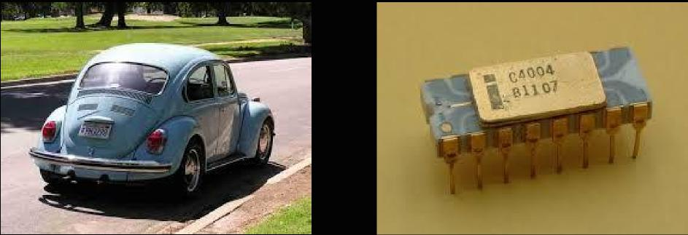
Evolution of the Workplace...today
What if ...a 1971 Volkswagen Beetle had advanced at the same pace as a 1971 Intel processor chip....? CEO Intel
Speed: Then? 75 mph. Now?... 300,000 mph.
Efficiency: Then? 24 mpg. Now?... 2 Million mpg.
Cost: Then? $1,950 Now?... 4 cents.
How has today’s equivalent workspace evolved? And how will tomorrow’s...?
Deloitte Confidential: Public Sector – For Approved External Use

Slide 12
Evolution of the Workplace... Who? Where? When? How?
Technology is everywhere
AI, Cognitive
Computing, Robotics
HOW...? |  | 20.8 billion connected devices in 2020
HOW...?
WHO...?
$500,000 in 2008 $22,000 today
Automation and
Replacement of Jobs
HOW...?
7
Disruptors
 | Tsunami of data 9x more in last 2 years
WHO...? HOW...? |  | 35% UK 47% US 77% China
WHO...? WHERE...? WHEN...?
WHO...?
Explosion in
Contingent Work
US Contingent workers 40% by 2020
Diversity and
Generational Change
Millennials 50%
Africa to supply 25% of global workforce in 2050
WHO...? WHERE...? WHEN...?
Change in nature
of a career
2.5 - 5 years: half-life of skills
Deloitte Confidential: Public Sector – For Approved External Use

Slide 13
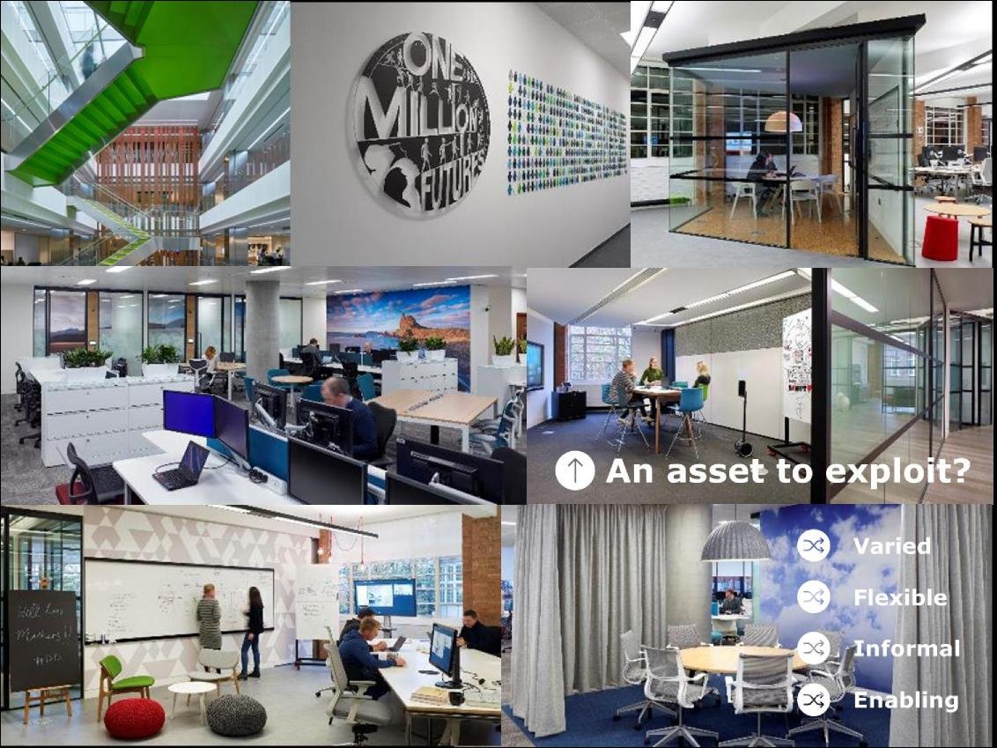
Precedents
Use the environment created to attract the best talent.
 | Millennials are entering the workforce in greater numbers and reshaping the talent markets with new expectations. They are projected to make up 75% of the global workforce by 2025” Global Human Capital Trends (Deloitte, 2015) “Of the 1bn young people who will enter the job market in the next decade, 60% are expected to get jobs that do not currently exist” (World Bank 2015)
Deloitte Confidential: Public Sector – For Approved External Use

Slide 14
Challenges
See the pace of change as an opportunity, view real estate as a key enabler, “componentise” best practice
The pace of change is frightening … but by future proofing can be an opportunity
It’s not just a real estate project…but real estate should be viewed as a key enabler
It’s difficult to decide the optimal best practice example…but components from each can be combined
Deloitte Confidential: Public Sector – For Approved External Use

Slide 15
Central St. Martins Kings Cross
Deloitte Confidential: Public Sector – For Approved External Use

Slide 16
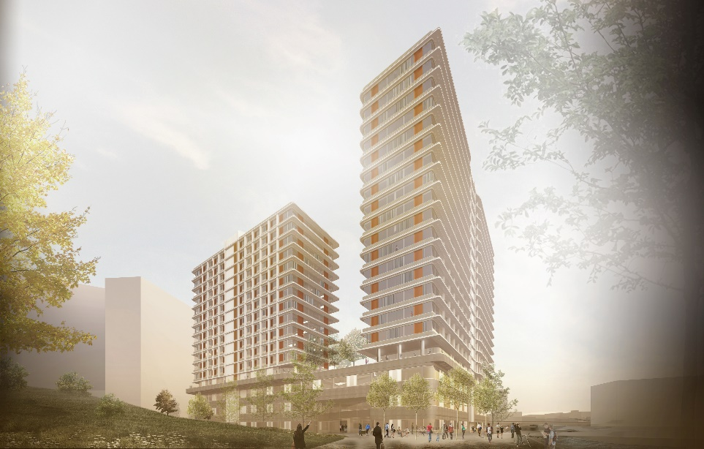
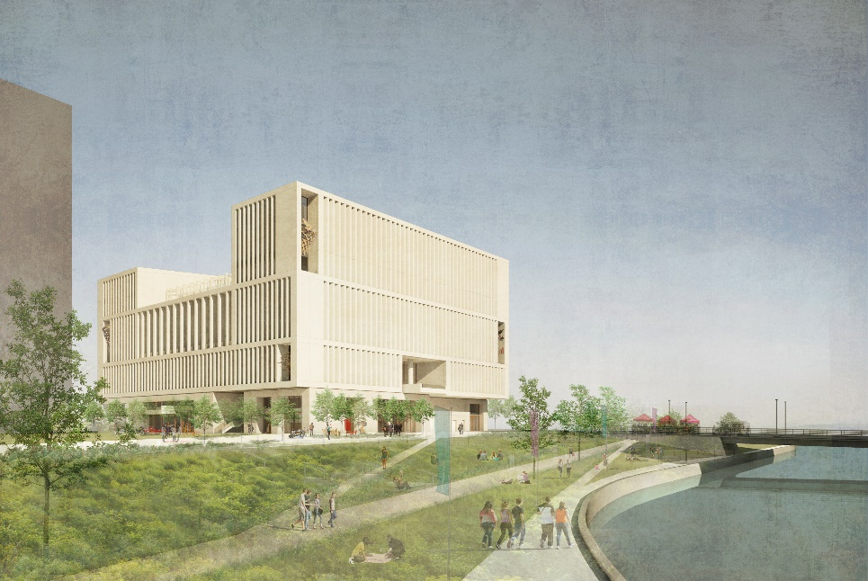
UCL East Outline Planning Permission for new 180,000 sqm campus.
Deloitte Confidential: Public Sector – For Approved External Use

Slide 17
Meeting the Demand for World-Class Facilities
A tax perspective

Slide 18
Meeting the Demand for World-Class Facilities
Public Realm
Wider university estate.
Interaction with non- university owned land.
Student Accommodation
Teaching Facilities
In-house vs out-sourced.
New builds – tax efficient arrangements.
Refurbishing existing aging teaching accommodation.
More interactive learning experience.
24 hour Learning Environment
Research Facilities
External funding.
Non-business vs business use.
Often high costs.
Transformation of estates to allow 24 hr learning experience.
Students studying in a different way.
Sporting Facilities
Higher expectations of students and non student users.
Deloitte Confidential: Public Sector – For Approved External Use

Slide 19
Case Study: University Facilities
Research Facilities
Non-business research activity may entitle the University to VAT relief on the construction costs (new build only).
Refurbishments/ conversions/extensions are unlikely to entitle the University to relief.
Commercial business activity could create VAT recovery.
Integration with the wider environment
Local Authorities have more favourable VAT refund regimes. Collaboration with LAs might reduce costs.
VAT treatment of contributions from third parties (the council) can be complex.
Residual VAT recovery considerations for public realm.
Sports Facilities
Commercial use of premises generates income and can potentially increase VAT recovery – e.g. sponsorship/adverts in sports facilities.
Whether the facilities are built in the University or a subsidiary may affect the tax position.
Deloitte Confidential: Public Sector – For Approved External Use

Slide 20
Diversification of activities
Commercial Activity
Commercial development.
Letting of commercial units.
Joint Ventures
Commercial Partners
Public Sector Partners
Conferencing Facilities
Third party hire
In-house use
Additional services – catering, hotel accommodation
Hotel Accommodation
Purpose built hotel accommodation.
Surplus student accommodation.
Deloitte Confidential: Public Sector – For Approved External Use

Slide 21
Case Study: Diversified Activities
Conference Facilities
University own-use or other educational conferences often lead to a lower VAT recovery position.
Commercial activity can potentially entitle the University to increased VAT recovery.
Supply of land vs supply of facilities – different supplies have different VAT treatments.
Joint Ventures/Multi-party use
Consider which party is best placed to procure and incur the costs – different tax recovery positions for each party.
Consider how each party will be granted access to the property and the associated tax position.
Commercial use of premises can potentially entitle the University to increased VAT.
Deloitte Confidential: Public Sector – For Approved External Use

Slide 22
Key Take Aways from the Session

Slide 23
The Estate Director’s Role
Key Observations
Future proof your solution – don’t plan for the
current generation, plan for the next...
01
02
Be agile – things will change, don’t be afraid to be flexible. Test as you go along
03
Identify key stakeholders & and articulating the benefits
04
Financial Impact – consider the tax implications
05
Value added specialist input
Deloitte Confidential: Public Sector – For Approved External Use

Slide 24
Questions?

