Slide 2
Grenfell Tower Tragedy – Implications on Construction Sector
Jon Pagan – Director of Fire Engineering
Glen Sumner – Associate Director

Slide 3
Intention of presentation
Not intended to cover Grenfell Tower fire itself
Only covering impact of the tragedy on the construction industry
Particular focus on educational sector

Slide 4
Hackitt Review
Dame Judith Hackitt leading a review of Building Regulations and fire safety
Interim Report was published in December 2017
Full report expected in May 2018
Interim report was mainly focussed on process
Did not cover detailed design issues
So this presentation based on Interim Report
Plus IFC’s assessment of likely changes to detailed design issues
Once full report published Secretary of State will decide what updates are needed

Slide 5
Key Focus Areas
Hackitt Report main focus was on:
Regulations
Competence
Quality assurance
‘Golden thread’
Detailed design issues likely to also affect:
Façade materials
Sprinklers

Slide 6
Regulations
New build/refurbishments covered by Building Regulations
Once complete, operational building covered by Fire Safety Order
Fire Safety Order does not cover private dwellings
So in blocks of flats only covers the communal areas
Flats may be covered by Housing Act
But confusing
Likely to be a change to ‘tidy up’

Slide 7
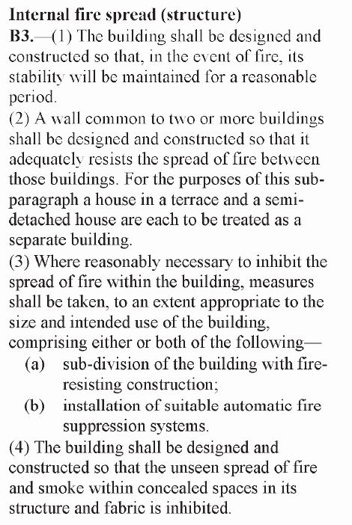
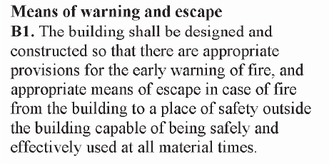
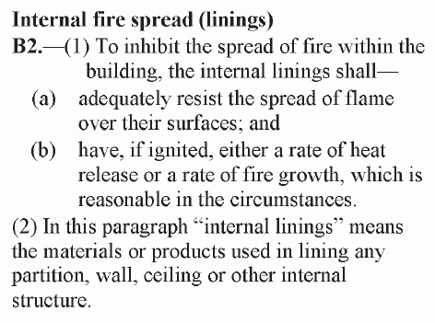
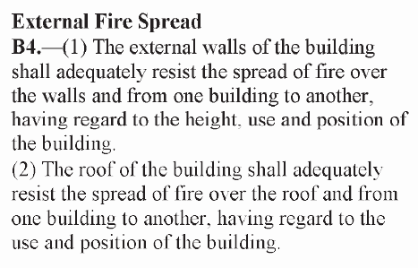
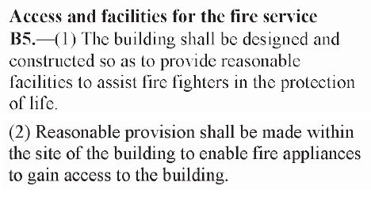
Building Regulations
Broken down into B1 to B5
B1 – Means of escape and warning
B2 – Internal fire spread (linings)
B3 – Internal fire spread (structure)
B4 – External fire spread
B5 – Access and facilities for fire service
Each individual Regulation is relatively short
Key question is what is “appropriate”
That is where guidance documents apply

Slide 8
Guidance documents
Secretary of State produces Approved Documents
Guidance, not Regulations
States that alternative solutions are acceptable if proven
Also refers to other documents (e.g. British Standards)
BS 9991 for residential buildings
BS 9999 for non-residential buildings
Others (e.g. HTM guidance for hospitals, BB100 for schools)

Slide 9
Fire Engineering
No need to follow any specific guidance document
As long as can justify that B1 to B5 are met
Fire Engineering can often be used to do that
As long as work is carried out by competent engineers
Issue of competence is addressed later

Slide 10
Competence within Fire Industry
Currently very little control of competence
Fire engineers not always used on projects
Even when they are used, anyone can claim to be a fire engineer
IFC estimate that only about 10% are Chartered through IFE
Others have no 3rd party confirmation of competence
Specifications of fire performance typically by architects
Fire testing is complex
Reaction to fire, fire resistance, non-combustible, limited combustibility
Manufacturers technical literature can often be misinterpreted
Architects can regularly specify incorrectly

Slide 11
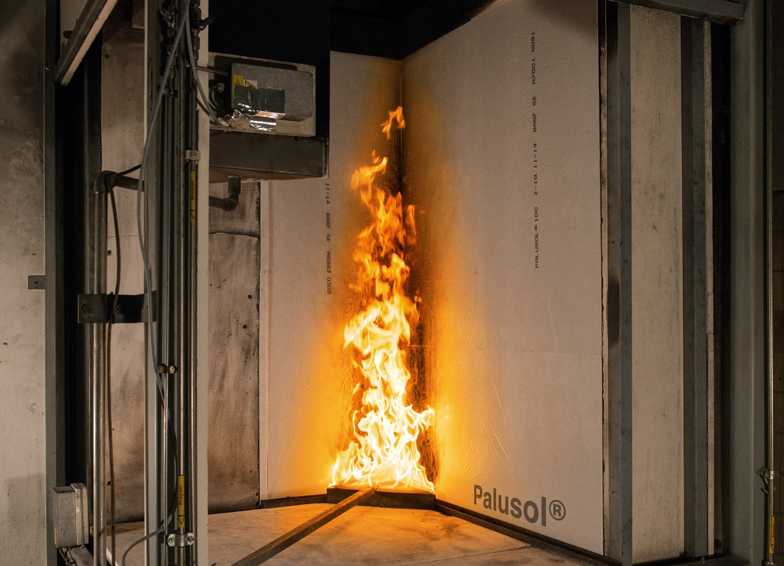
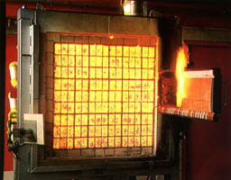
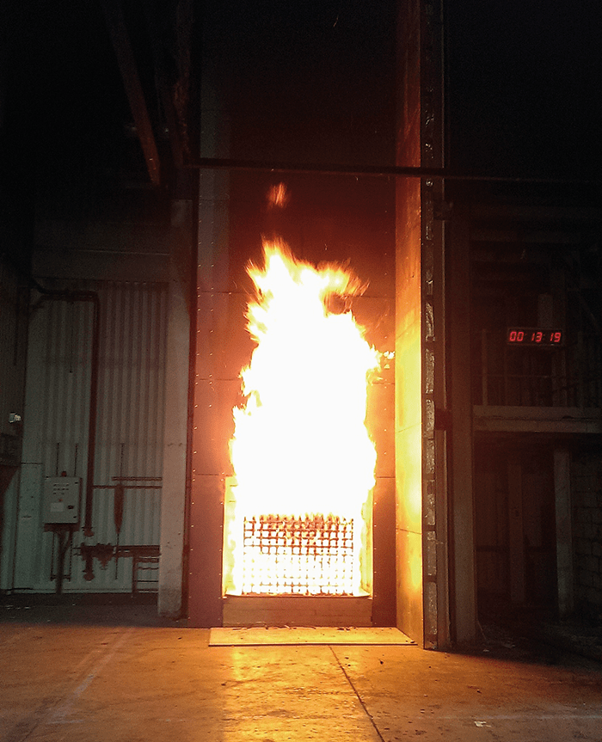
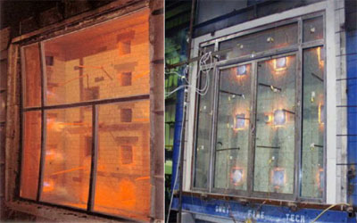

Slide 12
Competence within Fire Industry
Installers of fire safety systems/precautions need to be competent
Varying level of competence checks
Sprinkler installers tend to be 3rd party certified
Fire alarm installers until recently only had training available
FIA just introduced qualifications in fire alarms
Passive fire protection installers have 3rd party certification schemes
But not a requirement of Building Regulations
Often a client requirement but not always

Slide 13
Quality Control
Basic minimum for products is to have a fire test report
Could be 10 years ago
Is the product on site the same as that tested?
Changes to source materials, manufacturing methods would invalidate test
Installers also need to be competent
Using products and installers that are part of UKAS accredited 3rd Party Certification schemes should address that

Slide 14
Quality Control
Installation in hidden areas is regularly very poor
Fire stopping above suspended ceilings
Cavity barriers within external walls
Very poor quality control
These areas are difficult to access
So checking is hard
If faults identified, corrective work is very difficult

Slide 15
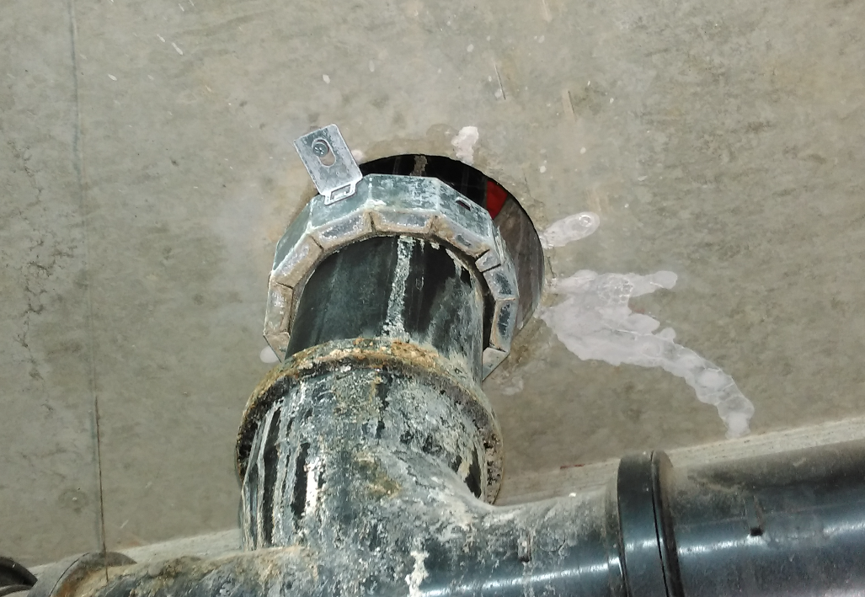

Slide 16
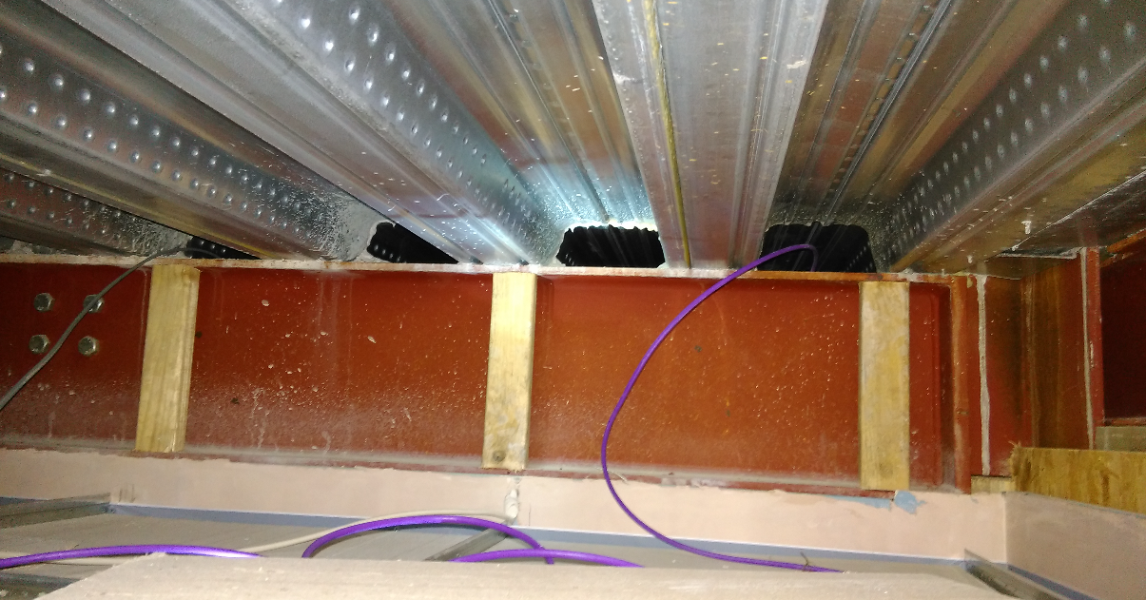

Slide 17
‘Golden Thread’

Slide 18
‘Golden Thread’
Product substitution is very common practice (almost endemic)
Does the replacement material still give the necessary fire performance?
If the accreditation/testing was for a system
any changes to the materials/product will invalidate it
Have any changes been updated on drawings, etc?

Slide 19
Façade Materials if >18m high
Currently 4 options
Option 1 – Limited combustibility
Option 2 – Use tested system (BR 135/BS 8414)
Option 3 – Use system which has ‘desktop study’ by competent fire engineer
Option 4 – Use fire engineered approach
If Option 3 is still allowed there will be restrictions on who carries them out
Possible that might only allow Option 1
Or may state that Chartered Fire Engineer needs to sign off design and/or installation

Slide 20
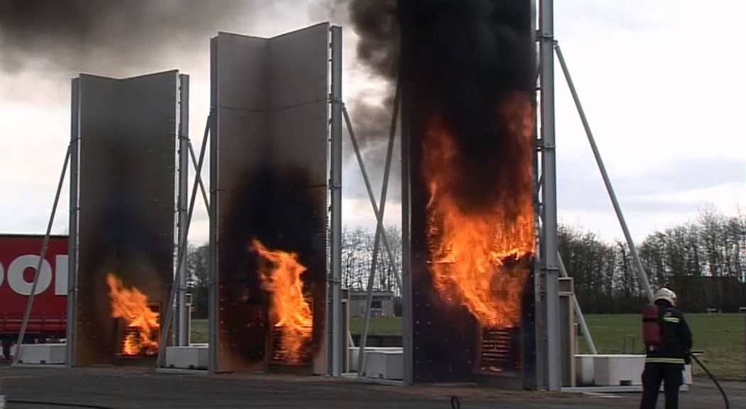

Slide 21
Sprinklers
Currently only needed if over 30m high
Or for travel distances (discussed earlier)
Possibility of this being extended
Buildings over 18m high?
All residential buildings?
Will be political negotiation on this issue

Slide 22
Other issues
Competence checks on fire risk assessors (operational buildings)
Regulation 38 pack of information not provided or enforced
Works on existing buildings should improve, rather than ‘not worsen’

Slide 23
Summary
Change of culture needed within industry
Designing to minimum standards not acceptable
Competence checks needed (3rd party)
Roles and responsibilities may need to change
Better control of works on site
Better quality control, especially hidden areas
More thorough checks on materials and installation
Product substitution to be controlled/restricted
Better documentation of installation

