Slide 1
Equality and Diversity and Estates AUDE Big Conversation, 25 January 2018

Slide 2
Equality Challenge Unit
Established in 2001 to promote equality for staff in higher education in the UK
Remit extended in 2006 to include students
Funded via subscription and, in Scotland and Wales, funding councils
Merging with Higher Education Academy and Leadership Foundation in 2018

Slide 3
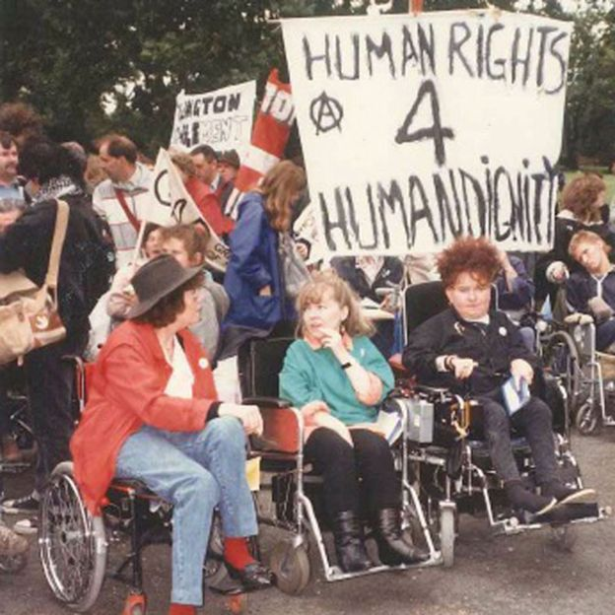
Changing times

Slide 4
Equality Act 2010
Applies to England, Scotland and Wales
Public HEIs must have due regard to the need to:
Eliminate unlawful discrimination, harassment and victimisation and other conduct prohibited by the Act
Advance equality of opportunity between people from different groups
Foster good relations

Slide 5
Equality Act 2010 – protected characteristics
age
disability
gender reassignment
marriage or civil partnership (in employment only)
pregnancy and maternity
race
religion or belief
sex
sexual orientation

Slide 6
Other legal/regulatory changes and drivers
Higher Education and Research Act 2017
HESA reporting requirements
Disabled Students’ Allowance reforms
Gender Action Plans – Scottish Funding Council
NIHR funding tied to Athena SWAN
Violence against Women, Domestic Abuse and Sexual Violence (Wales) Act 2015
‘Prevent Duty’

Slide 7
Student data

Slide 8
Student data

Slide 9
Student data
LGBT students who have experienced a form of homophobic, biphobic or transphobic harassment are 2–3 times more likely to consider leaving their course
One in seven LGB students and staff chose to study or work at their institution because it positively illustrated a commitment to LGB equality

Slide 10
Staff data

Slide 11
Staff data
Median gender pay gap for professional and support staff (PSS) in UK HE was 11.1% in 2015/16
11% of PSS were BME in 2015/16

Slide 12
Belonging

Slide 13
Belonging
“Students’ sense of being accepted, valued, included, and encouraged by others... More than simple perceived liking or warmth, it also involves support and respect for personal autonomy and for the student as an individual.”

Slide 14
Trans staff and students
“Trans Staff and students in HE and colleges: improving experiences” (2016)
Being asked not to use toilets or changing facilities that correspond to their gender identity
Lack of gender-neutral toilets and facilities

Slide 15
Students living at home
Around 50% of Black and Asian students live at home
80% of students aged over 26 live at home
Lack of a ‘place’ on campus – lockers, common room
Food, parking, security issues

Slide 16
ECU – forthcoming work
Religion and belief and good campus relations guidance
Inclusive environments in HE briefing series
Belonging and HE
www.ecu.ac.uk
david.malcolm@ecu.ac.uk

Slide 17
Equality and Diversity and Estates AUDE Big Conversation, 25 January 2018

