Slide 2
From “Pinks” to Performance
AUDE Big Conversation

Slide 3
Changing role of estates management over the years
“Getting with the act”
1992 Further and Higher Education Act
The pinks..
EMS
CO2
L&T
AUDE leading the professionalism of estates management for HE
3

Slide 4
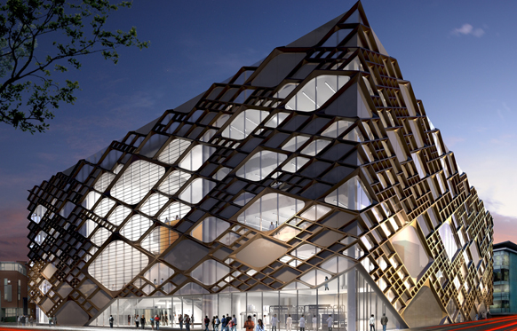
Changing role of estates management over the years
2017 – Higher Education and Research Act
How students learn is inseparable from where students learn; pedagogic shifts = environmental shifts.
Future
Digital strategies
Mergers, collaborations, acquisitions…
New providers; new partnerships
Governance
Student satisfaction
Learning environment (TEF)
Value for money…
4

Slide 5
Leadership in unchartered waters
Seaworthy for the future
Alison Johns, CEO Designate, new sector agency

Slide 6
Stripping back to the Leader-ship hull
Disclaimer:
I am not a nautical engineer...
…but we know what good leadership looks like
Creating the conditions in which staff can
perform and develop

Slide 7
Back to basics - Stripping back to the Leader-ship hull
A leadership ‘hull’; the essential structure:
Leading
Managing
Delegating and Distributing leadership
Teams
Inspiring
Listening
Setting the course (direction/strategy/visioning)
Developing and enabling
Horizon scanning
Navigating ‘choppy waters’

Slide 8
Overall shape of your leadership vessel
“The shape is chosen to strike a balance between:
Cost and …..
hydrostatics (accommodation, load carrying and stability),
hydrodynamics (speed, power requirements, motion and behaviour in a seaway)
the ship's role (distinctiveness)
the rounded bow of an icebreaker
the flat bottom of a landing craft….”

Slide 9
Masts/sails:
Capturing wind.. Growth, opportunity
Succession
Speed and power
Collaboration
Decks:
Delegation
Teams
Specialism/expertise
Culture
Stern/rudder:
Steer
Navigate
Correct course
Bow:
Direction
Negotiating resistance
Defence against over-spill
Hull:
Integrity
Honesty/openness…
…ensures the structure can float…
…base on which the ‘superstructure’ sits, with its various decks…
Image by Kevin Ryder

Slide 10
The hull
“The hull is the watertight body of a ship or boat.”
Water tight:
Integrity
Authenticity
Honesty/openness…
…ensures the structure can float…
…base on which the ‘superstructure’ sits, with its various decks…

Slide 11
Bow - The forward part of the hull of a ship
fore and forward mean towards the bow….
“The bow is designed to reduce the resistance of the hull cutting through water and should be tall enough to prevent water from easily washing over the top of it.”
Fore/ward:
Direction
Protection
Defense against over-spill
Negotiating resistance

Slide 12
Stern/rudder
“The stern is the back or aft-most part of a ship or boat, technically defined as the area built up over the sternpost…
A rudder is a primary control surface used to steer a ship…”
Stern/rudder:
Steer (rudder)
Redirection/correction (rudder)
Navigation (stern)

Slide 13
The Decks and crew
Rowing in the same direction?
“Eight people going backwards as fast as they can, without talking to each other, steered by the one person who can’t row”
But, they have;
confidence in each other
a shared commitment
a passion for the same goal, and
total confidence in the one person who can’t row
(Charles Handy)

Slide 14
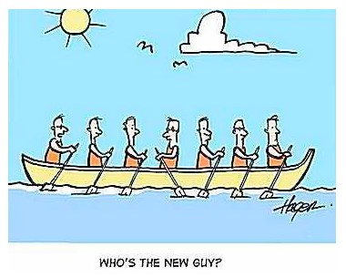
Crew changes and the art of leadership
Just one change can send a group back to ‘storming’
“Who’s the new guy?”

Slide 15
Masts/sails:
Capturing wind.. Growth, opportunity
Succession
Speed and power
Collaboration
Image by Kevin Ryder

Slide 16
Aims to
support the development of leaders who can not only thrive in a culture of change but also work collaboratively with diverse communities of colleagues to develop collective commitment, shared purpose and new and enhanced ways of working together.
Key ideas relating to this approach are:
Co-inquiry
Collaborative engagement
An appreciative spirit
Being at ease with complexity
University of Hertfordshire; FPD Case study, 2017
Notes:
https://lf4he.blog/tag/university-of-hertfordshire/

Slide 17
Future Professional Directors
17

Slide 18
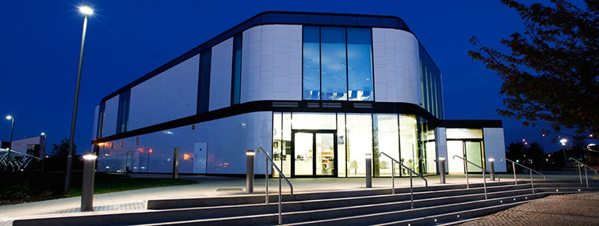
The Live Case Study: FP2 University of Hertfordshire
“An approach to process improvement within
Higher Education that focuses on people,
taking differing perspectives seriously,
in an iterative process of improvement
to enhance both individual and
organisational capability.
Key to its success is early and ongoing engagement with staff not as stakeholders but as full members of the improvement team.
The approach brings people together at the beginning of a project and encourages their involvement throughout. It focuses on facilitating discussion, raising awareness of processes, improving communications and building relationships.”
(Gill Sadler, Head of Planning, Development and Change, University of Hertfordshire)
University of Hertfordshire; FPD Case study, 2017
18

Slide 19
The Live Case Study: FP2 University of Hertfordshire
Everything became about engagement, from the questions the FPD participants asked and the way they asked them through to the detailed narratives the Hertfordshire team were able to share.
The learning itself became very deep, highly energised and multi-layered.
There was, for example, something fascinating and liberating about the way Hertfordshire had defined engagement based on four levels:
Attraction – to interest
Involvement – to draw in
Connection – to bring together
Bond – to build relationships
University of Hertfordshire; FPD Case study, 2017
19

Slide 20
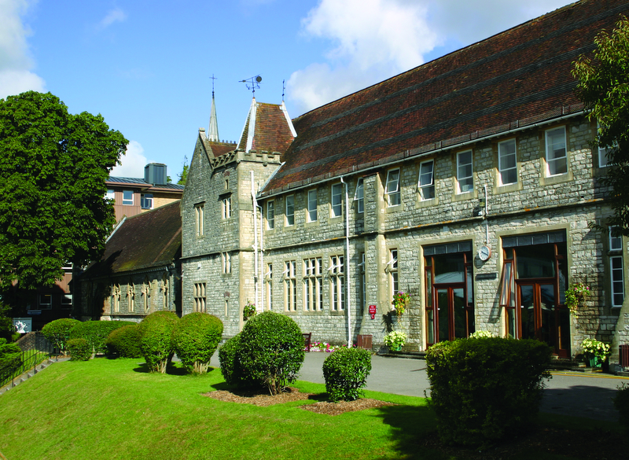
The Live Case Study: FPD3… University of Winchester
“Values based leadership”
The application deadline is on the Friday 23 February 2018 with the programme starting on the Wednesday 21 March.
University of Hertfordshire; FPD Case study, 2017
20

Slide 21
What FPDers say
“I now engage with people with my leader boots, hat and scarf on.”
“It has left me wanting more: to read more, to develop more, to understand myself and others more. It has whetted my appetite and created a thirst…”
“For any new or experienced leaders, this is an invaluable experience to really explore your own leadership style. Allow the experience to flow over you and be as open as you can be with your fellows on FPD - the more you commit to the programme, the more you will get from it.”
“FPD has genuinely been a transformative experience for many of us in this second cohort. It's allowed me to build upon my strengths whilst really developing and improving aspects of leadership I wasn't tuned into previously.”

Slide 22
Investing in and enabling your crew
Active talent management – building estates for the future, that are flexible to as yet unknown change… the same must be said of your workforce:
Competition for people
‘Smart estates’ – digital futures
Automation
Private providers; privatised talent…
Distributed leadership:
Succession planning
22

Slide 23
Seaworthy for change

Slide 24
Changing Spaces
Six provocations
Provocation 1: Create the culture before the building: make
Changing Spaces a ‘state of mind’
Provocation 2: Communication, communication,
communication: never enough, never good enough and
never early enough
Provocation 3: You really have to have the right people in
the right place at the right time
Provocation 4: Don’t underestimate people’s connection to
their ‘spaces’ and communities, and symbols of same
Provocation 5: Emotions are a central part of Changing
Spaces
Provocation 6: Ignore Maslow at your peril!

Slide 25
Changing Spaces
How can leadership and management create the best conditions for success?
The cases in this study that were far and away the most successful were those where Changing Spaces was:
• Undertaken proactively and led by a compelling vision that inspired those involved.
• A cultural “state of mind” rather than a building.
• Characterised by well thought-through consultative modes of communication.
• Inclusive of as many members of staff and students as possible, at
appropriate times and in role-relevant ways.
• Enacted with awareness of the social and psychological importance of
“space” and communities of practice.
• Encompassing of basic needs as well as meta strategy.

Slide 26
Something to reflect on…
How are you leading your crew?
How are you investing in your crew?
How seaworthy is your leadership for the unchartered seas ahead?
How are you looking after and preparing you?

Slide 27
Thank you for listening
Alsion.johns@lfhe.ac.uk

